Slide 1
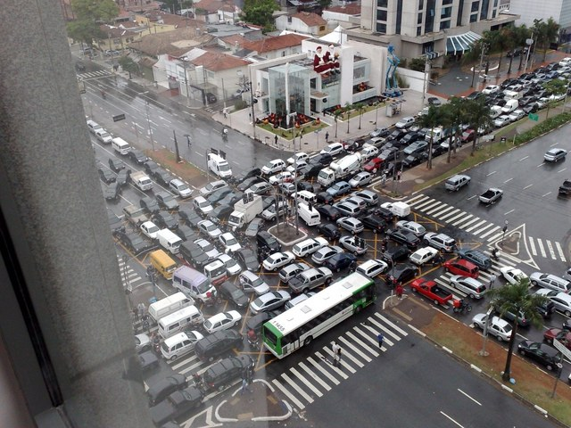
Multiprocessor Synchronization
CSCI 1760
Concurrent Skip Lists
Lecture 20
December 2024
Maurice Herlihy
Brown University

Slide 2
Set Interface
Unordered collection of items
No duplicates
Methods
add(x) puts x in collection
remove(x) takes x out of collection
contains(x) tests if x is in collection

Slide 3
List-Based Sets
public interface Set<T> {
public boolean add(T x);
public boolean remove(T x);
public boolean contains(T x);
}

Slide 4
Set Method Mix
4
Notes:
4

Slide 5
Binary Search Tree
x
keys < x
Challenge: balance
keys > x

Slide 6
Balanced via Rotations
x
y
a
A
b
c
B
C

Slide 7
Rotation (1)
y
x
c
C
a
A
b
B

Slide 8
Rotation (2)
y
x
c
C
a
A
b
B

Slide 9
Hard to Parallelize
y
x
right
x
c
a
y
C
A
left
a
b
b
c
A
B
B
C

Slide 10
Skip Lists
Probablilistic Data structure
No global rebalancing
Logarithmic depth
0
9
7
5
8
2
Notes:
One efficient way to do it is with a skip-list.
A skip list keeps the elements sorted in nodes that are linked in multiple layers, such that every layer is a sublist of the layer underneath it.
So as you can see, the bottom layer contains all the elements, and in the next layer we skip 2, and so on, so that in the last layer we only have the 0 and 9 nodes. So now if we’re searching for 8, for example,

Slide 11
Skip List Property
Each layer is a sub-list of lower levels
0
9
Notes:
One efficient way to do it is with a skip-list.
A skip list keeps the elements sorted in nodes that are linked in multiple layers, such that every layer is a sublist of the layer underneath it.
So as you can see, the bottom layer contains all the elements, and in the next layer we skip 2, and so on, so that in the last layer we only have the 0 and 9 nodes. So now if we’re searching for 8, for example,

Slide 12
Skip List Property
Each layer is a sub-list of lower levels
0
9
7
Notes:
One efficient way to do it is with a skip-list.
A skip list keeps the elements sorted in nodes that are linked in multiple layers, such that every layer is a sublist of the layer underneath it.
So as you can see, the bottom layer contains all the elements, and in the next layer we skip 2, and so on, so that in the last layer we only have the 0 and 9 nodes. So now if we’re searching for 8, for example,

Slide 13
Skip List Property
Each layer is a sub-list of lower levels
0
9
7
5
Notes:
One efficient way to do it is with a skip-list.
A skip list keeps the elements sorted in nodes that are linked in multiple layers, such that every layer is a sublist of the layer underneath it.
So as you can see, the bottom layer contains all the elements, and in the next layer we skip 2, and so on, so that in the last layer we only have the 0 and 9 nodes. So now if we’re searching for 8, for example,

Slide 14
Skip List Property
Each layer is a sub-list of lower levels
0
9
7
5
8
Notes:
One efficient way to do it is with a skip-list.
A skip list keeps the elements sorted in nodes that are linked in multiple layers, such that every layer is a sublist of the layer underneath it.
So as you can see, the bottom layer contains all the elements, and in the next layer we skip 2, and so on, so that in the last layer we only have the 0 and 9 nodes. So now if we’re searching for 8, for example,

Slide 15
Skip List Property
Each layer is a sub-list of lower levels
0
9
7
5
8
2
Notes:
One efficient way to do it is with a skip-list.
A skip list keeps the elements sorted in nodes that are linked in multiple layers, such that every layer is a sublist of the layer underneath it.
So as you can see, the bottom layer contains all the elements, and in the next layer we skip 2, and so on, so that in the last layer we only have the 0 and 9 nodes. So now if we’re searching for 8, for example,

Slide 16
Skip List Property
Each layer is a sub-list of lower levels
Not easy to preserve concurrently
0
9
7
5
8
2
Notes:
One efficient way to do it is with a skip-list.
A skip list keeps the elements sorted in nodes that are linked in multiple layers, such that every layer is a sublist of the layer underneath it.
So as you can see, the bottom layer contains all the elements, and in the next layer we skip 2, and so on, so that in the last layer we only have the 0 and 9 nodes. So now if we’re searching for 8, for example,

Slide 17
Search
contains(8)
0
9
7
5
8
2
Notes:
We do not need to go through all the nodes preceding it, because we can start in the top layer, and once we hit 7 we know that everything that precedes 7 also precedes 8, and therefore we can skip the 2 and 5 nodes and only search between 7 and 9.
So the idea is that each layer contains exponentially fewer nodes so that we can get an efficient search operation, which is very important.
This was Sequential

Slide 18
Search
contains(8)
Too far
0
9
7
5
8
2
Notes:
We do not need to go through all the nodes preceding it, because we can start in the top layer, and once we hit 7 we know that everything that precedes 7 also precedes 8, and therefore we can skip the 2 and 5 nodes and only search between 7 and 9.
So the idea is that each layer contains exponentially fewer nodes so that we can get an efficient search operation, which is very important.
This was Sequential

Slide 19
Search
contains(8)
OK
0
9
7
5
8
2
Notes:
We do not need to go through all the nodes preceding it, because we can start in the top layer, and once we hit 7 we know that everything that precedes 7 also precedes 8, and therefore we can skip the 2 and 5 nodes and only search between 7 and 9.
So the idea is that each layer contains exponentially fewer nodes so that we can get an efficient search operation, which is very important.
This was Sequential

Slide 20
Search
contains(8)
Too far
0
9
7
5
8
2
Notes:
We do not need to go through all the nodes preceding it, because we can start in the top layer, and once we hit 7 we know that everything that precedes 7 also precedes 8, and therefore we can skip the 2 and 5 nodes and only search between 7 and 9.
So the idea is that each layer contains exponentially fewer nodes so that we can get an efficient search operation, which is very important.
This was Sequential

Slide 21
Search
contains(8)
Too far
0
9
7
5
8
2
Notes:
We do not need to go through all the nodes preceding it, because we can start in the top layer, and once we hit 7 we know that everything that precedes 7 also precedes 8, and therefore we can skip the 2 and 5 nodes and only search between 7 and 9.
So the idea is that each layer contains exponentially fewer nodes so that we can get an efficient search operation, which is very important.
This was Sequential

Slide 22
Search
contains(8)
Found it!
0
9
7
5
8
2
Notes:
We do not need to go through all the nodes preceding it, because we can start in the top layer, and once we hit 7 we know that everything that precedes 7 also precedes 8, and therefore we can skip the 2 and 5 nodes and only search between 7 and 9.
So the idea is that each layer contains exponentially fewer nodes so that we can get an efficient search operation, which is very important.
This was Sequential

Slide 23
Search
contains(8)
Found it!
0
9
7
Log N
5
8
2
Notes:
We do not need to go through all the nodes preceding it, because we can start in the top layer, and once we hit 7 we know that everything that precedes 7 also precedes 8, and therefore we can skip the 2 and 5 nodes and only search between 7 and 9.
So the idea is that each layer contains exponentially fewer nodes so that we can get an efficient search operation, which is very important.
This was Sequential

Slide 24
Why Logarthimic
Each pointer at layer i jumps over roughly 2^{i} nodes
Hard to ensure deterministically, so randomize
2^{i}
2^{i}
0
9
7
5
8
2
Notes:
One efficient way to do it is with a skip-list.
A skip list keeps the elements sorted in nodes that are linked in multiple layers, such that every layer is a sublist of the layer underneath it.
So as you can see, the bottom layer contains all the elements, and in the next layer we skip 2, and so on, so that in the last layer we only have the 0 and 9 nodes. So now if we’re searching for 8, for example,

Slide 25
Sequential Find
int find(T x, Node<T>[] preds, Node<T>[] succs) {
…
}
Notes:
Moreover, Doug Lea already implemented a nonblocking concurrent skip-list based on Fraser’s PhD. The only problem is that it is complicated. <click>

Slide 26
Sequential Find
int find(T x, Node<T>[] preds, Node<T>[] succs) {
…
}
object height
(-1 if not there)
Notes:
Moreover, Doug Lea already implemented a nonblocking concurrent skip-list based on Fraser’s PhD. The only problem is that it is complicated. <click>

Slide 27
Sequential Find
int find(T x, Node<T>[] preds, Node<T>[] succs) {
…
}
object height
(-1 if not there)
Object sought
Notes:
Moreover, Doug Lea already implemented a nonblocking concurrent skip-list based on Fraser’s PhD. The only problem is that it is complicated. <click>

Slide 28
Sequential Find
int find(T x, Node<T>[] preds, Node<T>[] succs) {
…
}
object height
(-1 if not there)
Object sought
return predecessors
Notes:
Moreover, Doug Lea already implemented a nonblocking concurrent skip-list based on Fraser’s PhD. The only problem is that it is complicated. <click>

Slide 29
Sequential Find
int find(T x, Node<T>[] preds, Node<T>[] succs) {
…
}
object height
(-1 if not there)
Object sought
return predecessors
return successors
Notes:
Moreover, Doug Lea already implemented a nonblocking concurrent skip-list based on Fraser’s PhD. The only problem is that it is complicated. <click>

Slide 30
Successful Search
preds
find(7, …)
4
3
2
1
0
0
9
7
5
8
2
Notes:
The node containing 7 has height 4, so it has no previous node at level 5. The predecessor at the other levels are all node 5.

Slide 31
Successful Search
preds
succs
find(7, …)
4
4
3
3
2
2
1
1
0
0
0
9
7
5
8
2
Notes:
The node containing 7 has height 4, so it has no previous node at level 5. The predecessor at the other levels are all node 5.

Slide 32
Unsuccessful Search
preds
find(6, …)
4
3
2
1
0
0
9
7
5
8
2
Notes:
The node containing 7 has height 4, so it has no previous node at level 5. The predecessor at the other levels are all node 5.

Slide 33
Unsuccessful Search
preds
succs
find(6, …)
4
4
3
3
2
2
1
1
0
0
0
9
7
5
8
2
Notes:
The node containing 7 has height 4, so it has no previous node at level 5. The predecessor at the other levels are all node 5.

Slide 34
Lazy Skip List
Mixed blocking and non-blocking
add(), remove() optimistic lazy locking
contains() wait-free
Notes:
Used the same approach to implement a concurrent skip-list.
To show you how simple our algorithm is, I’ll demonstrate to you how the add operation works.

Slide 35


Lazy List Review
a
d
a
b
c
Add a Boolean marked field to each item

Slide 36
Lazy List Review
a
d
a
b
c
Present in list

Slide 37
Lazy List Review
a
d
a
b
c
Logically removed
Art of Multiprocessor Programming
37
Notes:
37

Slide 38

Lazy Removal
a
d
a
b
c
Physically removed

Slide 39
Lazy Skip List
Add a Boolean marked field to each node
0
0
9
0
0
7
0
5
0
8
0
2
Notes:
One efficient way to do it is with a skip-list.
A skip list keeps the elements sorted in nodes that are linked in multiple layers, such that every layer is a sublist of the layer underneath it.
So as you can see, the bottom layer contains all the elements, and in the next layer we skip 2, and so on, so that in the last layer we only have the 0 and 9 nodes. So now if we’re searching for 8, for example,

Slide 40
add(6)
Create node of (randomly chosen) height 4
6
0
9
7
0
5
8
0
2
Notes:
So suppose we would like to add this node with the value 6 into the skip-list. <click>

Slide 41
add(6)
Create node of (randomly chosen) height 4
6
Call find() to get predecessors
6
0
9
0
7
0
5
8
0
2
Notes:
The first thing we do is a wait-free search to find the location where it should be added, and its potential predecessors --- that is, the nodes after which it should be added in each layer. <click>

Slide 42
add(6)
Create node of (randomly chosen) height 4
6
Call find() to get predecessors
6
Lock predecessors
0
9
0
7
0
0
5
8
0
2
Notes:
The first thing we do is a wait-free search to find the location where it should be added, and its potential predecessors --- that is, the nodes after which it should be added in each layer. <click>

Slide 43
add(6)
Create node of (randomly chosen) height 4
6
Call find() to get predecessors
6
Lock predecessors
validate
0
9
0
7
0
0
5
8
0
2
Notes:
The first thing we do is a wait-free search to find the location where it should be added, and its potential predecessors --- that is, the nodes after which it should be added in each layer. <click>

Slide 44
add(6)
Create node of (randomly chosen) height 4
Call find() to get predecessors
6
Lock predecessors
validate
Splice & unlock
0
9
0
7
0
5
0
8
0
2
Notes:
Once Validation succeeded, we can splice in the node.

Slide 45
add(6)
Create node of (randomly chosen) height 4
Call find() to get predecessors
Lock predecessors
validate
Splice & unlock
0
9
0
6
7
0
5
0
8
0
2
0
Notes:
then unlock, and we’re done.
Selavie.
[Get here after 5 minutes]
Now the question, of course, is whether this simple approach can perform as well as the lock-free algorithm. So let me show you some graphs.

Slide 46
remove(6)
0
9
0
6
7
0
0
5
0
8
0
2
0
Notes:
then unlock, and we’re done.
Selavie.
[Get here after 5 minutes]
Now the question, of course, is whether this simple approach can perform as well as the lock-free algorithm. So let me show you some graphs.

Slide 47
remove(6)
Call find() to get predecessors
0
9
0
6
7
0
0
5
0
8
0
2
0
Notes:
then unlock, and we’re done.
Selavie.
[Get here after 5 minutes]
Now the question, of course, is whether this simple approach can perform as well as the lock-free algorithm. So let me show you some graphs.

Slide 48
remove(6)
Call find() to get predecessors
Lock victim
0
9
0
6
7
0
0
5
0
8
0
2
0
Notes:
then unlock, and we’re done.
Selavie.
[Get here after 5 minutes]
Now the question, of course, is whether this simple approach can perform as well as the lock-free algorithm. So let me show you some graphs.

Slide 49
remove(6)
Call find() to get predecessors
Lock victim
Set mark (if not already set)
Logical remove…
0
9
0
6
7
0
5
0
8
0
2
0

Slide 50
remove(6)
Call find() to get predecessors
Lock victim
Set mark (if not already set)
Lock predecessors & validate
0
9
0
6
7
1
0
5
0
8
0
2
0
Notes:
then unlock, and we’re done.
Selavie.
[Get here after 5 minutes]
Now the question, of course, is whether this simple approach can perform as well as the lock-free algorithm. So let me show you some graphs.

Slide 51
remove(6)
Call find() to get predecessors
Lock victim
Set mark (if not already set)
Lock predecessors & validate
Physical delete
0
9
0
6
7
1
0
5
0
8
0
2
0
Notes:
then unlock, and we’re done.
Selavie.
[Get here after 5 minutes]
Now the question, of course, is whether this simple approach can perform as well as the lock-free algorithm. So let me show you some graphs.

Slide 52
remove(6)
Call find() to get predecessors
Lock victim
Set mark (if not already set)
Lock predecessors & validate
Physical delete
0
9
0
6
7
1
0
5
0
8
0
2
0
Notes:
then unlock, and we’re done.
Selavie.
[Get here after 5 minutes]
Now the question, of course, is whether this simple approach can perform as well as the lock-free algorithm. So let me show you some graphs.

Slide 53
remove(6)
Call find() to get predecessors
Lock victim
Set mark (if not already set)
Lock predecessors & validate
Physical delete
0
9
0
6
7
1
0
5
0
8
0
2
0
Notes:
then unlock, and we’re done.
Selavie.
[Get here after 5 minutes]
Now the question, of course, is whether this simple approach can perform as well as the lock-free algorithm. So let me show you some graphs.

Slide 54
remove(6)
Call find() to get predecessors
Lock victim
Set mark (if not already set)
Lock predecessors & validate
Physical delete
0
9
0
6
7
1
0
5
0
8
0
2
0
Notes:
then unlock, and we’re done.
Selavie.
[Get here after 5 minutes]
Now the question, of course, is whether this simple approach can perform as well as the lock-free algorithm. So let me show you some graphs.

Slide 55
remove(6)
Call find() to get predecessors
Lock victim
Set mark (if not already set)
Lock predecessors & validate
Physical delete
0
9
0
7
0
5
0
8
0
2
0
Notes:
then unlock, and we’re done.
Selavie.
[Get here after 5 minutes]
Now the question, of course, is whether this simple approach can perform as well as the lock-free algorithm. So let me show you some graphs.

Slide 56
contains(8)
Call find() to get predecessors
0
9
0
6
7
0
0
5
0
8
0
2
0
Notes:
then unlock, and we’re done.
Selavie.
[Get here after 5 minutes]
Now the question, of course, is whether this simple approach can perform as well as the lock-free algorithm. So let me show you some graphs.

Slide 57
contains(8)
Call find() to get predecessors
Note 6 removed during traversal!
0
9
0
6
7
0
0
5
0
8
0
2
0
Notes:
then unlock, and we’re done.
Selavie.
[Get here after 5 minutes]
Now the question, of course, is whether this simple approach can perform as well as the lock-free algorithm. So let me show you some graphs.

Slide 58
contains(8)
Call find() to get predecessors
Note 6 removed during traversal!
6
0
9
0
7
0
5
0
8
0
2
0
Notes:
then unlock, and we’re done.
Selavie.
[Get here after 5 minutes]
Now the question, of course, is whether this simple approach can perform as well as the lock-free algorithm. So let me show you some graphs.

Slide 59
contains(8)
Call find() to get predecessors
Prove: unmarked nodes always reachable
Note 6 removed during traversal!
6
0
9
0
7
0
5
0
8
0
2
0
Notes:
then unlock, and we’re done.
Selavie.
[Get here after 5 minutes]
Now the question, of course, is whether this simple approach can perform as well as the lock-free algorithm. So let me show you some graphs.

Slide 60
Linearization Point: remove(6)
Successful remove: linearized when bit is set
Logical remove…
0
9
0
6
7
0
5
0
8
0
2
0
Notes:
then unlock, and we’re done.
Selavie.
[Get here after 5 minutes]
Now the question, of course, is whether this simple approach can perform as well as the lock-free algorithm. So let me show you some graphs.

Slide 61
Linearization Point: add
6
Successful add() only when fully linked
Use fullylinked Boolean to mark
Contains spins until fullylinked set
0
9
0
7
0
5
0
8
0
2
0
Notes:
Once Validation succeeded, we can splice in the node.

Slide 62
Linearization Point: unsuccessful contains?
6
7
1
1
So far OK…
0
9
0
5
0
8
0
2
0
Notes:
then unlock, and we’re done.
Selavie.
[Get here after 5 minutes]
Now the question, of course, is whether this simple approach can perform as well as the lock-free algorithm. So let me show you some graphs.

Slide 63
Linearization Point: unsuccessful contains?
What if new 7 added concurrently?
6
7
0
9
0
7
5
0
8
0
2
0
Notes:
then unlock, and we’re done.
Selavie.
[Get here after 5 minutes]
Now the question, of course, is whether this simple approach can perform as well as the lock-free algorithm. So let me show you some graphs.

Slide 64
Linearization Point: unsuccessful contains?
What if new 7 added concurrently?
6
7
Prove: 7 was absent at some instant
0
9
0
7
5
0
8
0
2
0
Notes:
then unlock, and we’re done.
Selavie.
[Get here after 5 minutes]
Now the question, of course, is whether this simple approach can perform as well as the lock-free algorithm. So let me show you some graphs.

Slide 65
A Simple Experiment
Each thread: 1 million ops
Add, remove, or contains
Operation & value chosen at random
Notes:
To summaries, I presented the lazy skip list --- a concurrent lock-based skip-list algorithms that perform almost as well as the lock-free solution --- but it is simple.
Thank you.

Slide 66
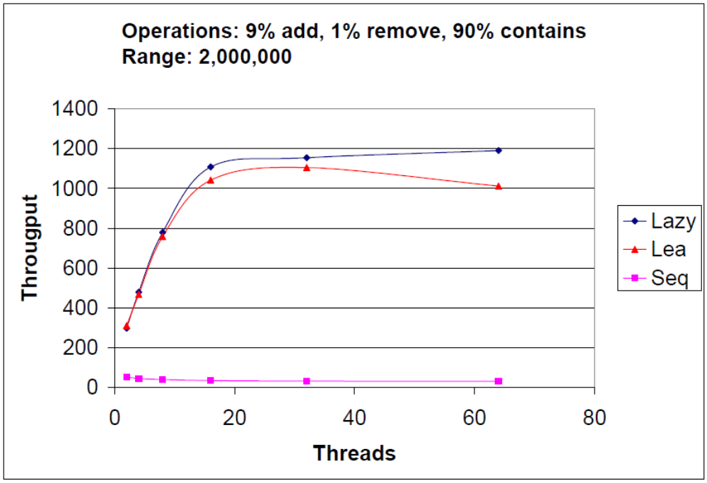
Lazy Skip List: Performance
Multiprogramming
Notes:
We conducted a simple experiment in which each thread executes 1 million operations in which it either adds, removes or searches an integer taken from a given range. Each operation is chosen in random from some distribution --- here, for example, we wanted to test with low contention, so we had 90% search operations, and a big range for the elements. We compared our lazy algorithm, with Lea’s lock-free implementation, and just to put the results in perspective we also implemented a simple sequential algorithm that uses synchronized methods --- that is, one big lock on the whole skip-list.
As you can see, our algorithm perform as well if not better than the non-blocking algorithm, even when the number of threads exceeds the number of processors.
Contention on locks
Range matters because more operations contend on the same item.

Slide 67
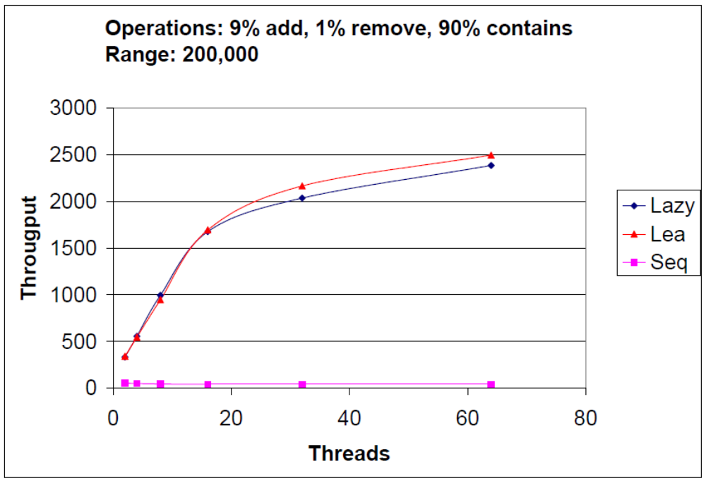
Lazy Skip List: Performance
Higher contention
Multiprogramming
Notes:
If we increase the contention by reducing the range, then our throughput in the multiprogramming zone is a bit lower than Lea’s throughput, but overall they’re still essentially the same.
Just to make sure that the problem is indeed contention, we tried to test it with a non-realistic contention <click>

Slide 68
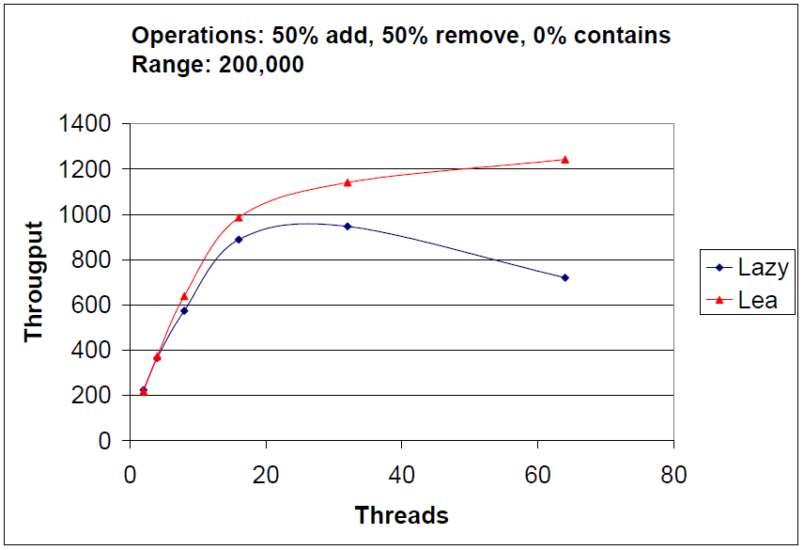
Lazy Skip List: Performance
Unrealistic Contention
Multiprogramming
Notes:
In which we’re doing only remove and add, and we saw that indeed our algorithm performance degrades when approaching the multiprogramming zone. That’s not surprising for us, because right now we have an optimistic algorithm with no contention control --- that is, if validates fails after the wait-free traversal, we immediately retry with no back-off. So one thing we would like to explore is how better contention control can help fixing this problem.

Slide 69

Lazy Skip List
Optimistic fine-grained locking
Performs as well as sophisticated
lock-free in “common cases”
But much simpler
Notes:
To summaries, I presented the lazy skip list --- a concurrent lock-based skip-list algorithms that perform almost as well as the lock-free solution --- but it is simple.
Thank you.

Slide 70
This work is licensed under a Creative Commons Attribution-ShareAlike 2.5 License.
You are free:
  to Share — to copy, distribute and transmit the work
  to Remix — to adapt the work
Under the following conditions:
  Attribution. You must attribute the work to “The Art of Multiprocessor Programming” (but not in any way that suggests that the authors endorse you or your use of the work).
  Share Alike. If you alter, transform, or build upon this work, you may distribute the resulting work only under the same, similar or a compatible license.
For any reuse or distribution, you must make clear to others the license terms of this work. The best way to do this is with a link to
  http://creativecommons.org/licenses/by-sa/3.0/.
Any of the above conditions can be waived if you get permission from the copyright holder.
Nothing in this license impairs or restricts the author's moral rights.

